Slide 1
BEADITUP.JA
Software Design

Slide 2
TABLE OF CONTENTS
01
02
03
Class Diagram
BACKGROUND
Architectural Design
Overview
Pattern
Justification
Components
Description
Interaction

Slide 3
BACKGROUND
01
General overview of the organization

Slide 4
Overview
BEADITUP JA is a small internet-based business, that provides homemade beaded bracelets to consumers. Order, inventory and delivery management are all done by the business owner
A software solution to replace or automate these manual processes will be able improve the efficiency in the business

Slide 5
Architectural Design
02
Pattern
Justification

Slide 6
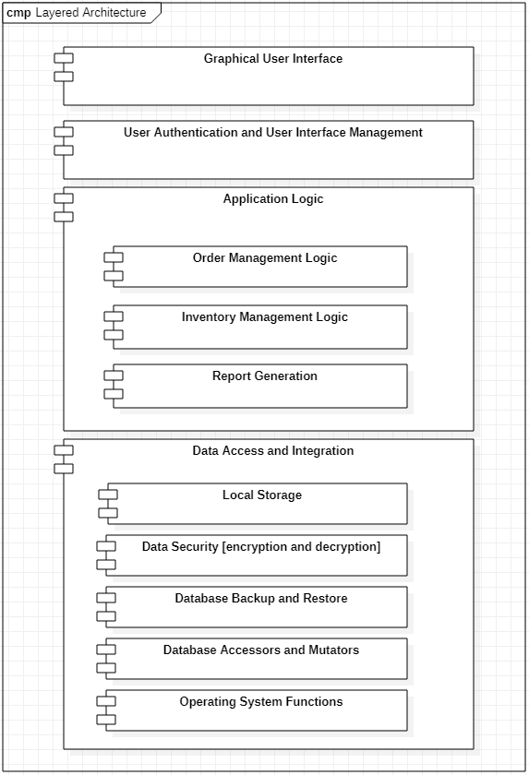
LAYERED ARCHITECTURE

Slide 7
JUSTIFICATION
Layered Architecture
Separation of Services
Performance Time
Multi-level Security
Non-Functional Requirements
Client-server and Layered model considerations
Comparison
Trade-off

Slide 8
CLASS DIAGRAM
03
COMPONENTS
DESCRIPTION
INTERACTION

Slide 9
Components
User Authentication and Interface Management:
Authentication and User Class
Order Management Logic
Order, Customer, Pickup,
Inventory Management
Bracelet, Report, Stock, StockType<<enum>>, Size<<enum>>
Report Generation
Report

Slide 10
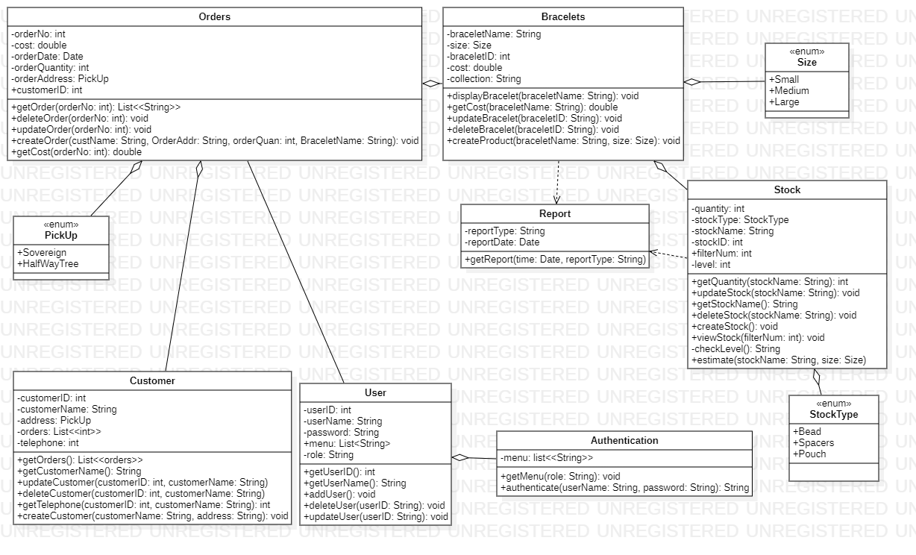
CLASS DIAGRAM
3.
5.
7.
6.
4.
1.
2.

Slide 11
THANKS!
Any questions?
GROUP MEMBERS:
MARLON LEWIS
CALLAY JARRETT
GABRIEL SCOTT
MERCEDES SMITH
TAYE-VAUGHN JONES
KIMANI MUNN

